Slide 1
Content Objective: Students will use post-it notes and create a gallery walk of information for 3 foundational ethical terms.
Monday Nov. 4
Finish What is AI? Ethics?
The Moral Compass
Absolutism vs. Relativism vs. Objectivism
Homework
During projects only...
Feel free to write and speak in your native language when I ask you questions. If there is someone next to you that you can translate for please do!

Slide 2



AI & Ethics - You Teach Me...
What do we already know about AI & Ethics? Let’s define AI / Ethics...

Slide 3



The Sea Captain Problem
The year is 1600 and you’re on a boat that is trying to sail across the ocean. What tool can you use to help you cross? What if you did not have that tool? What might happen to your boat?

Slide 4

Moral Compass - Do You Have One?
What does a Compass do?
Do you need a Moral Compass to survive in life?

Slide 5
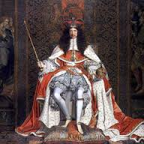
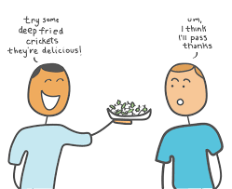

Absolutism Relativism Objectivism
This guy rules the land and says that slavery is bad and humans should be free. Should we give him more power if he has good ethics?
Is this glass half full or half empty?
Is there a truth separate from human thought that just is?
Where does this truth come from?
You like eating deep fried crickets. I don’t. Who cares, it’s all relative!

Slide 6
Absolutism Relativism Objectivism
Use post-it notes / gallery walk style.

Slide 7


AI is a tool just like the compass...if the compass was broken or built wrong what might happen?
Ending Note

Slide 8


My Results
What am I missing...
Who would I be best matched with?
What about you? Find 1-2 people to complete a group!

